Slide 1


My First Project : The Soldering Station
Ceyhan Yildiz

Slide 2

Soldering Station : What to expect
1.0
Why this Project
Functionality
PCB
Case
Best Moments
Worst Moments
Cost

Slide 3
Why this Project
2.0
Simplifying Complexity
Learning from Others
Notes:
Simplifying Complexity : We mochten kiezen, Hard Time S1 Learning from Others : Same Project For exempel True is beter than SMD

Slide 4
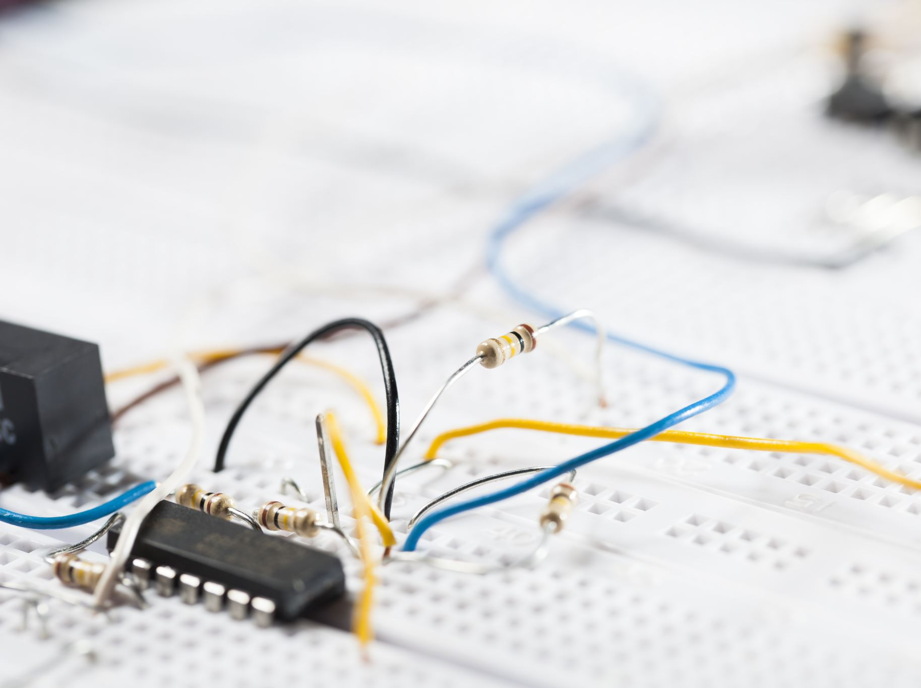
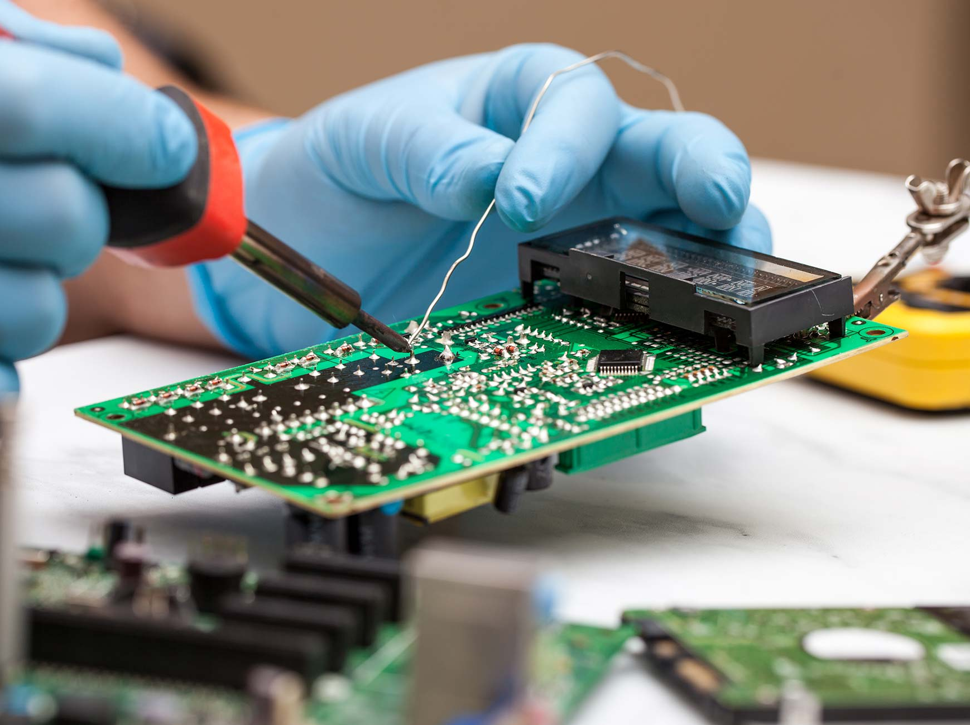

functionality
3.0
Soldering Iron
Components to be Soldered
Power Supply Unit
Temperature Control Mechanism
Notes:
Soldering Iron:
Illustration of a soldering iron with a metal tip.
Components to be Soldered:
Small electronic components, such as resistors or capacitors, represented by symbols or icons.
Connection lines between the components.
Power Supply Unit:
Box representing the power supply unit.
Temperature Control Mechanism:
Rotary knob
Connection lines linking the temperature control mechanism to the soldering iron.
Soldering Process:
Illustration of the soldering iron touching the component leads and the circuit board.
Heat waves emanating from the soldering iron to indicate the heating process.
Melting solder represented by droplets or lines bonding the component leads and the circuit board.
Result:
Illustration of a completed solder joint with the components securely connected to the circuit board.

Slide 5
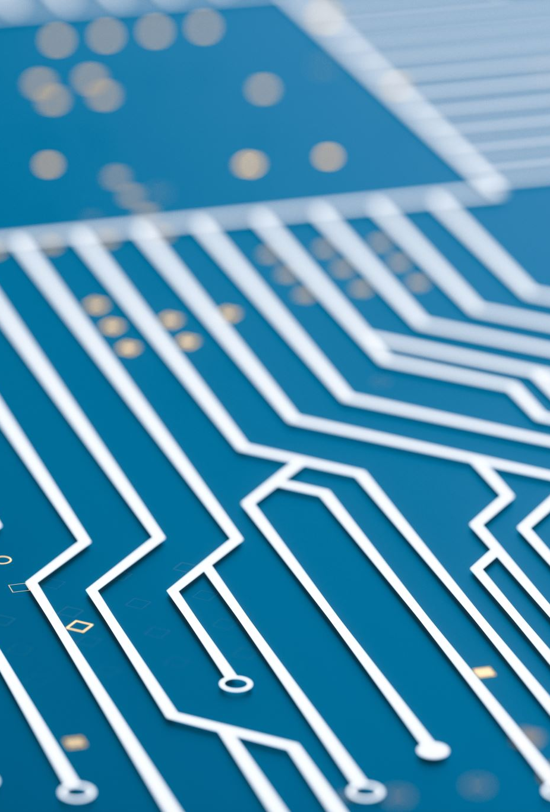
PCB
4.0
Schematics
Thermokoppel
Voeding
CPY
PBM
Display
Manufactory
Soldering

Slide 6
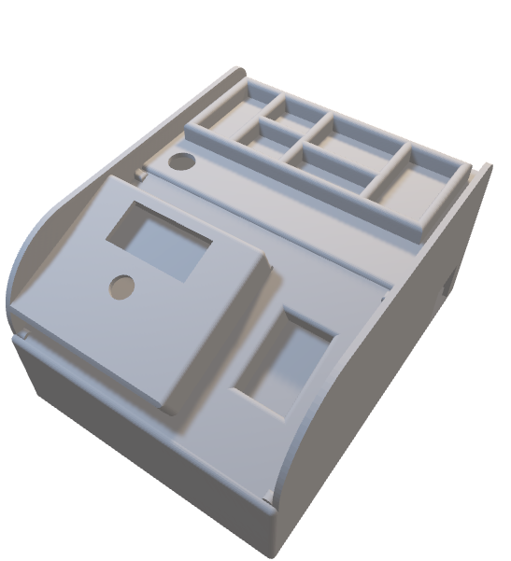
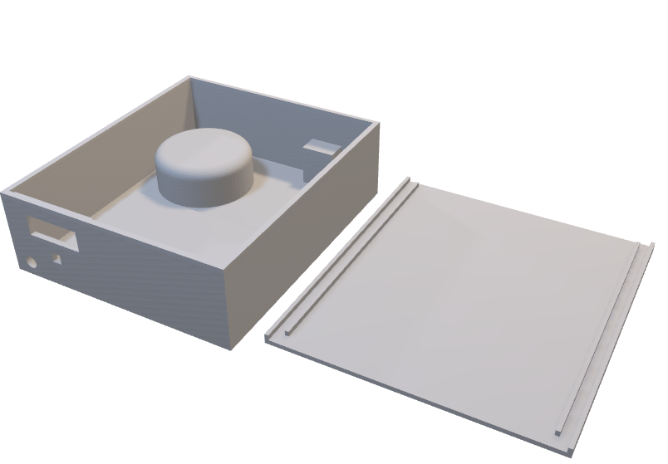
case design
5.0
Version 0.1
Version 0.0
Notes:
Lost hope
Did not gave up

Slide 7
Best Moments
6.0
Learned
Ready for the NEXT

Slide 8
Worst Moments
7.0
Price
Silkscreen
Timing
Learning
Incomplete
Notes:
Not knowing the correct Prices Silkscreen to small pcb took to long to arrivé Learing curve Altium Designer
Not done

Slide 9
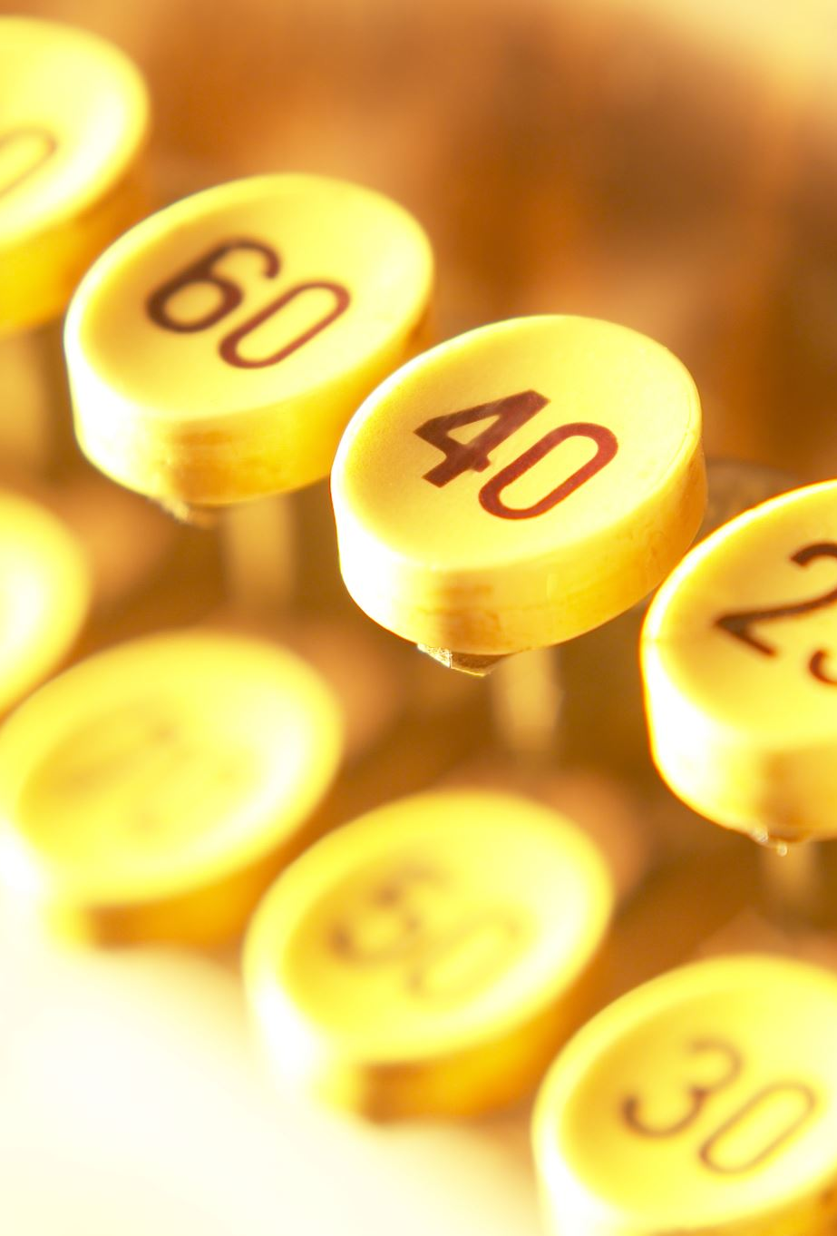
Cost Breakdown
8.0
Components : €35
PCB : €32
Toroidal transformer : €25 – €40
Extra :
Display : €1,60
Case : €25
Soldering iron : €15
Total : €133,6 – €148,6

Slide 10

THANKS for your attentions

